Slide 1


Fuel consumption estimation of a commercial ship
Alexioy kyriakos

Slide 2
Presentation structure
Data
ML model
Framework
Results

Slide 3

DATA
BULK CARRIER 80000DWT
46 days (01/04/2022 to 16/5/2022)
Sampling Rate 0,016Hz
65868 Instances
63 Attributes
Label = ME FUEL CONSUMPTION

Slide 4

Ml model
DATA PREPROCESSING
ATTRIBUTES EXCLUDED (DOMAIN EXPERTISE)
DATETIME,
MAGNETIC COURSE OVER GROUND
MAGNETIC VARIATION
MAIN ENGINE FUEL INDEX
MAIN ENGINE SCAVENGE AIR RECEIVER TEMPERATURE
TURBOCHARGER LUB OIL INLET PRESSURE
TURBOCHARGER LUB OIL INLET TEMPERATURE
MOVING AVERAGE (ISO-15016 OF 2015)
“ WINDOW OF 10’ ”

Slide 5
Ml model
DATA PREPROCESSING
ATTRIBUTES EXCLUDED (EXTREMELY LOW CORELLATION) function: vis_attr() file ml_training.py
PROPELLER SHAFT REVOLUTIONS
LONGITUDINAL GROUND SPEED
LONGITUDINAL WATER SPEED
TRIM
SCALLING (StandardScaler)
FIT ON TRAINING DATA
MISSING DATA IMPUTATION
DROPPED INSTANCES WERE LABEL = NULL
IMPUTE DATA STRATEGY = IMPUTE MEAN OF ATTRIBUTE
MUTUAL INFORMATION
mutual_info_regression() keep 34 highest score attributes (experimental)

Slide 6
Ml model
STRATEGY: Test different models using cross-validation keep most “stable” model
MODELS TESTED
LINEAR REGRESSION (BASELINE)
SVM REGRESSOR
GRADIENTBOOSTING REGRESSOR (BOOSTING)
BAGGING REGRESSOR with kNN estimator (BAGGING)

Slide 7
Ml model
MODEL TUNING AND SELECTION
DIFFERENT TEST SET AND TRAINING SET
TEST SET = COMPLETELY DIFFERENT TRIP
HYPERPARAMETER STRATEGY
Cross-validating grid-search (10 folds)
Metric (RMSE)
Check Mean value and Standard Deviation
BEST MODEL = GradientBoosting Regressor
(Learning rate = 0.1, Max depth = 5, L2_regularization = 0.001)

Slide 8
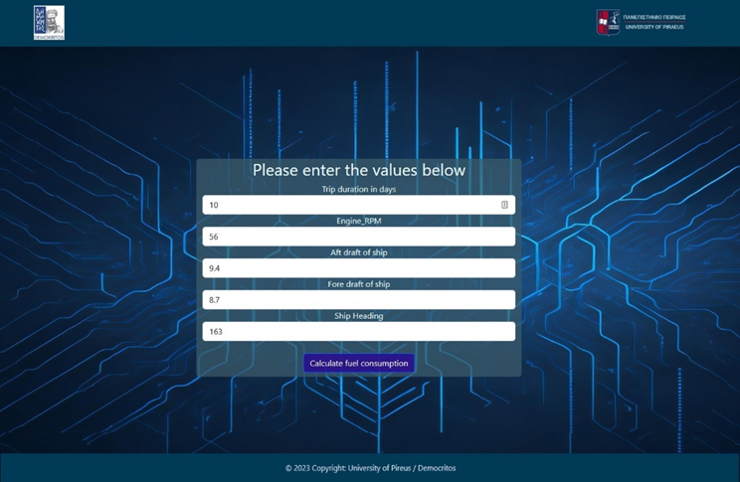
framework
WEB APPLICATION
DJANGO FRAMEWORK
INPUT DATA FORM
Trip Duration
Engine RPM
Aft Draft
Fore Draft
Heading

Slide 9
framework
INPUT DATA CREATION
INPUT DATA TYPE 1 (FORM)
Constitute ship (input by user)
INPUT DATA TYPE 2 (OPERATIONAL)
Operational parameters of ADLM
Simulated by create_var_inherited() and create_var_dummy() of file var_creation.py using physical model of ship
INPUT DATA TYPE 3 (ENVIROMENTAL)
Data provided by external providers (e.g windy API)
Simulated by create_random_env_vars() of file var_creation.py

Slide 10

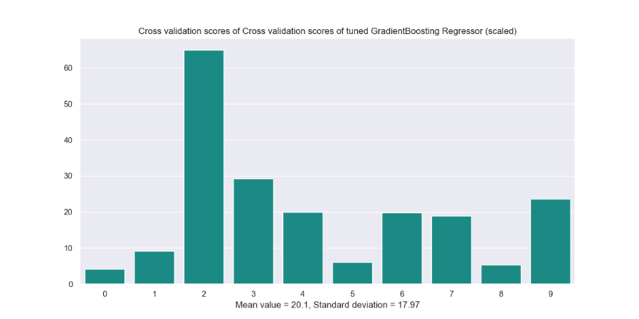
results
Test dataset : RPM span 3.15 to 83.6
Maximum error: 169.59 Lt/min
Mean absolute error: 18.87 Lt/min
*Average fuel consumption 150.000 to 200.000 Lt/Day

Slide 11
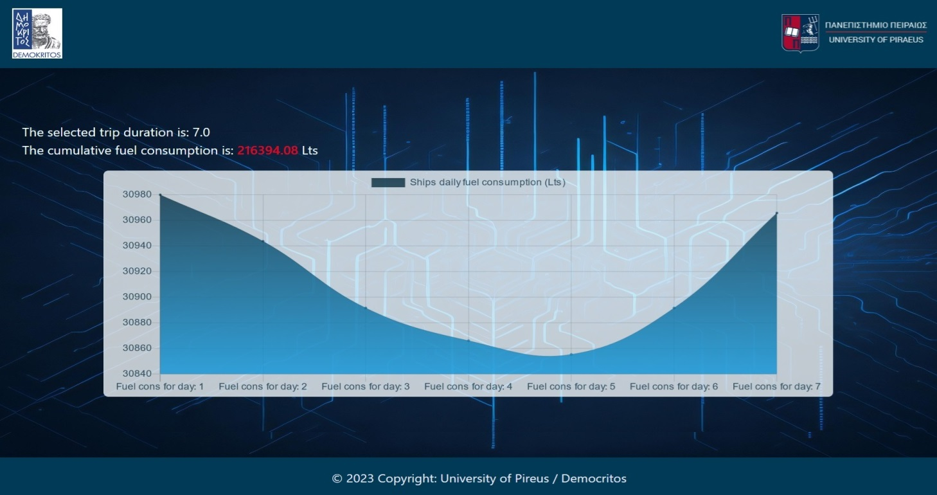
results

Slide 12

Thank you!
https://github.com/kiriakos2004/ml_assign_Democritos.git

